Slide 1
CHGM-141
General and Analytical Chemistry I
Lecturer 14
(Ch. 6) with Dr. Bailey
Chemical Reactions
Chemical Reactions
Balancing Chemical Equations

Slide 2
Our toolbox
We’ve now filled our toolbox with the basic tools required to discuss real chemistry:
Nomenclature
Conversion factors - Units! Units! Units
Significant figures/accuracy
Atomic Theory
Moles! Moles! Moles!

Slide 3
Real Chemistry
Real Chemistry is all about doing chemical reactions.
Chemistry is about making or breaking bonds in order to rearrange atoms and make new compounds.

Slide 4
Stoichiometry
Our favorite word!

Slide 5
Real Chemistry
Real Chemistry obeys our 2 Rules of Chemistry:
UNITS! UNITS! UNITS!
MOLES! MOLES! MOLES!

Slide 6
Chemical Reactions
I could describe a chemical reaction using words:
“Hydrogen and oxygen react to form water”.
I can even be more specific:
“Two diatomic hydrogen molecules and one diatomic oxygen molecule will react under XYZ conditions to form 2 molecules of water”

Slide 7
Chemical Shorthand
It is more concise to use chemical shorthand and write a chemical equation:
2 H₂ + O₂ → 2 H₂O
_{xyz}
2 H₂ + O₂ → 2 H₂O

Slide 8
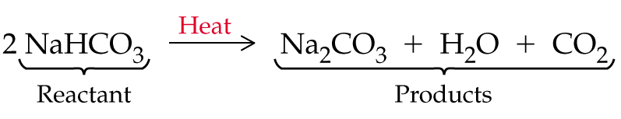
Chemical Equations
Chemical equation: An expression in which symbols and formulas are used to represent a chemical reaction.
Reactant: A substance that undergo changes in a chemical reaction and is written on the left side of the reaction arrow in a chemical equation.
Product: A substance that is formed in a chemical reaction

Slide 9
Chemical equations
Chemist’s shorthand to describe a reaction.
It contains:
  All reactants
  All products
  The state of all substances
  Any conditions used in the reaction
    CaCO_{3 (s)} CaO _{(s)} + CO_{2 (g)}
Δ
Reactant Products
Notes:
2

Slide 10
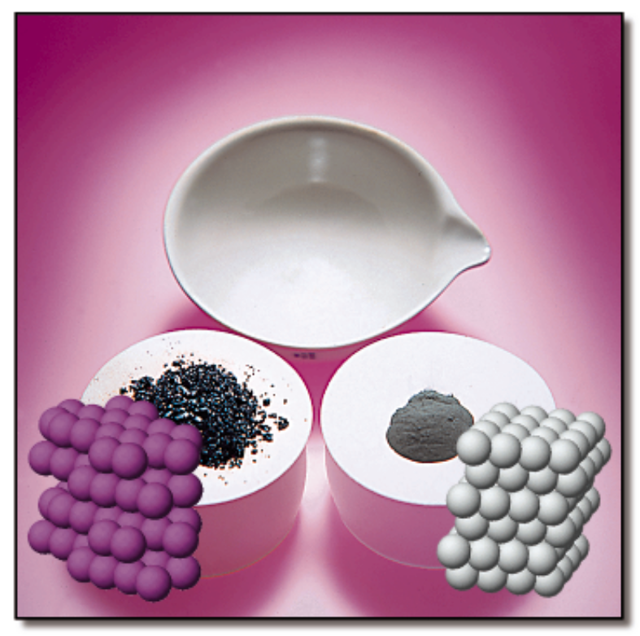
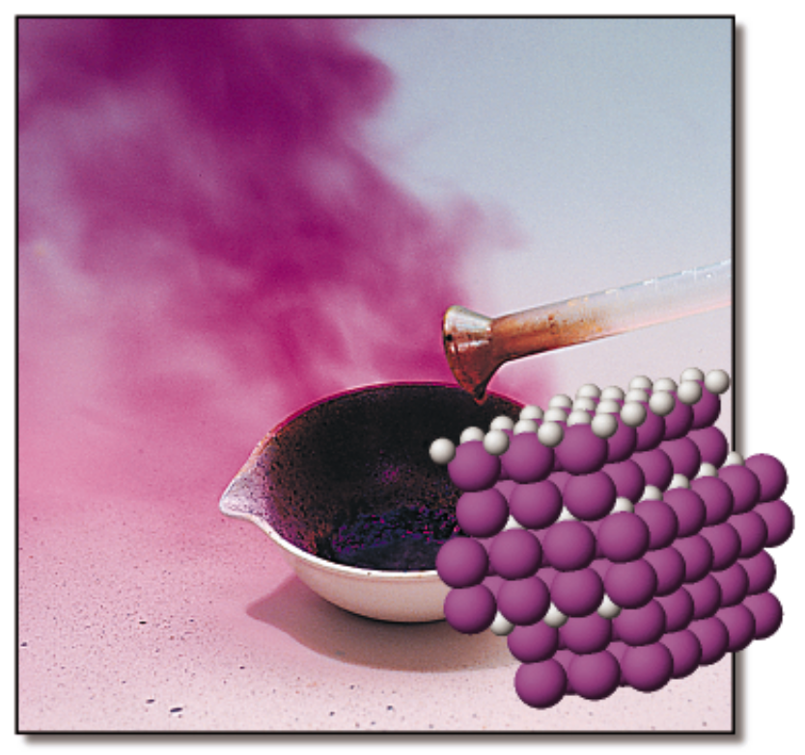
CHEMICAL REACTIONS
Reactants: Zn + I₂
Product: Zn I₂

Slide 11
Chemical Equations
Depict the kind of reactants and products and their relative amounts in a reaction.
4 Al(s) + 3 O₂(g) ---> 2 Al₂O₃(s)
The numbers in the front are called
stoichiometric coefficients
The letters (s), (g), and (l) are the physical states of compounds.

Slide 12
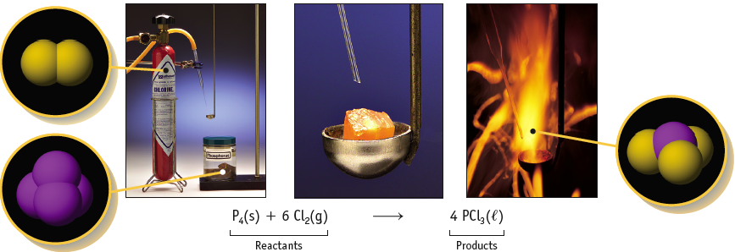
Reaction of Phosphorus with Cl₂
Notice the stoichiometric coefficients and the physical states of the reactants and products.

Slide 13
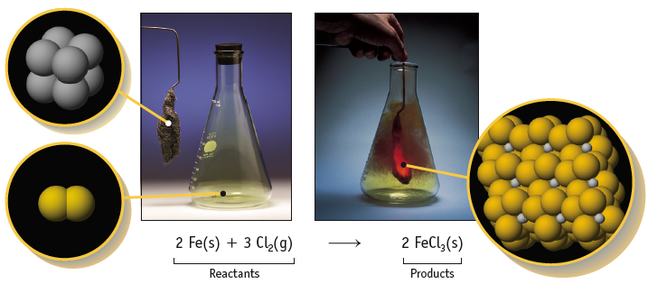
Reaction of Iron with Cl₂
Notice the stoichiometric coefficients and the physical states of the reactants and products.

Slide 14
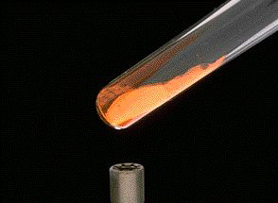
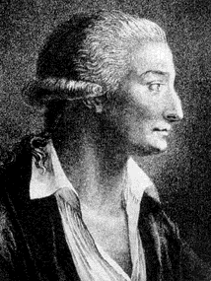
Chemical Equations
Because the same atoms are present in a reaction at the beginning and at the end, the amount of matter in a system does not change.
The Law of the Conservation of Matter
An equation must be balanced.
It must have the same number of atoms of the same kind on both sides.
The numbers in the front are called
stoichiometric coefficients
2HgO(s) ---> 2 Hg(liq) + O₂(g)
Lavoisier, 1788

Slide 15
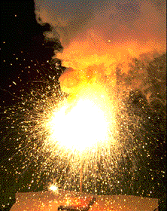
Chemical Equations
4 Al(s) + 3 O₂(g) ---> 2 Al₂O₃(s)
This equation means
4 Al atoms + 3 O₂ molecules ---give --->
2 “molecules” of Al₂O₃
4 moles of Al + 3 moles of O₂ ---give --->
2 moles of Al₂O₃

Slide 16
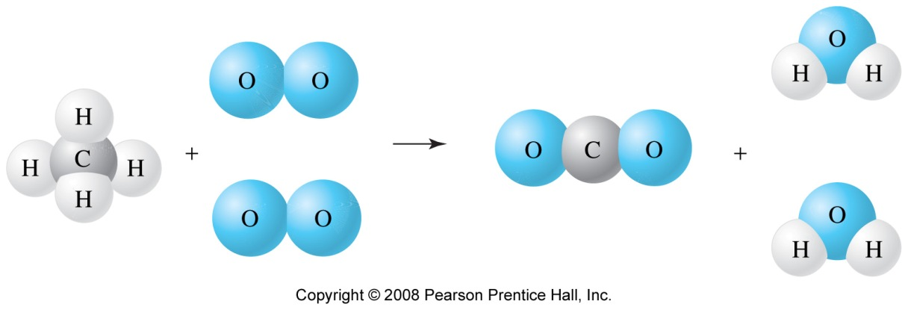
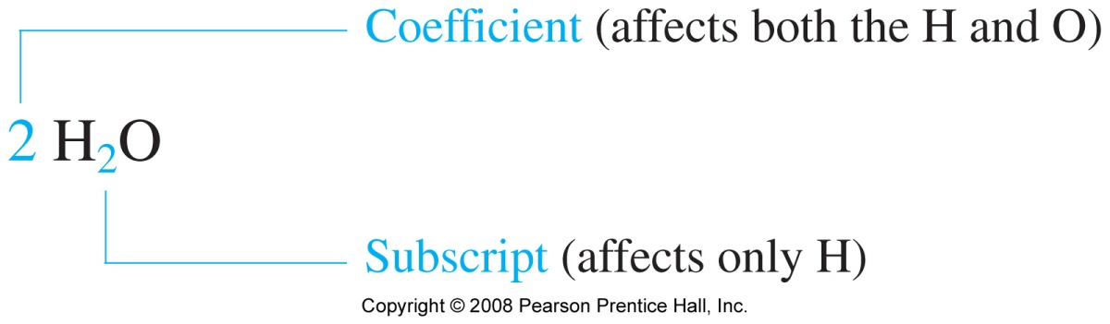
CH₄ + 2 O₂ → CO₂ + 2 H₂O

Slide 17
Guidelines for Balancing Equations:
  Balance elements other than H and O first
  Balance as a group any polyatomic ions that appears unchanged on both sides of the arrow
  Balance separately those elements that appear somewhere by themselves
As a general rule you should use the smallest whole-number coefficients when writing balanced chemical equations
Stoichiometry general plan

Slide 18
Balancing chemical equations
Each side of a chemical equation must have the same number and type of atoms.
It all must add up.
      CaCO_{3 (s)} CaO _{(s)} + CO_{2 (g)}
      Reactants Products
        1 Ca 1 Ca
        1 C 1 C
        3 O 3 O
Notes:
3

Slide 19
Balancing chemical equations
Step 1 Count the number of atoms of each element on both sides of the equation.
Step 2 Determine which atoms are not balanced.
Step 3 Balance one atom at a time using coefficients in front of one or more chemicals.
Step 4 Whenever you feel that things have been balanced, repeat Step 1.
Notes:
4

Slide 20
Balance the following
HCl + Ca _____> CaCl₂ + H₂
Step 1 & 2 1 H 2 H - not balanced
    1 Cl 2 Cl - not balanced
    1 Ca 1 Ca
Step 3 2 HCl + Ca _____> CaCl₂ + H₂
Step 4 2 H 2 H
    2 Cl 2 Cl
    1 Ca 1 Ca
The balanced equation
      2 HCl + Ca _____> CaCl₂ + H₂
Notes:
5

Slide 21
Balance the following
C₂H₆ + O₂ _____> CO₂ + H₂O
Step 1 & 2 2 C 1 C - not balanced
    6 H 2 H - not balanced
    2 O 3 O - not balanced
Step 3 Balance biggest molecule first, C₂H₆
      C₂H₆ + O₂ _____> 2 CO₂ + 3 H₂O
Step 4 2 C 2 C
    6 H 6 H
    2 O 7 O - not balanced
Notes:
6

Slide 22
Balance the following
C₂H₆ + O₂ _____> 2 CO₂ + 3 H₂O
Step 3a Now let’s balance for O₂
      C₂H₆ + 3.5 O₂ _____> 2 CO₂ + 3 H₂O
Step 4a 2 C 2 C
    6 H 6 H
    7 O 7 O
You can’t have 3.5 O_{2.} Double the equation!
Balanced Equation
        2 C₂H₆ + 7 O₂ _____> 4 CO₂ + 6 H₂O
Notes:
7

Slide 23
Example.
Decomposition of urea
  (NH₂)₂CO + H₂O ______> NH₃ + CO₂
2 N 1 N < not balanced
    6 H 3 H < not balanced
    1 C 1 C
    2 O 2 O
We need to double NH₃ on the right.
  (NH₂)₂CO + H₂O ______> 2 NH₃ + CO₂
Notes:
8

Slide 24
Another example
CH₃OH + PCl₅ _____> CH₃Cl + POCl₃ + H₂O
1 C 1 C
    4 H 5 H
    1 O 2 O
    1 P 1 P
    5 Cl 4 Cl
We need another Cl on the right.
  Increase CH₃Cl then recheck.
Notes:
9

Slide 25
Another example.
CH₃OH + PCl₅ _____> 2 CH₃Cl + POCl₃ + H₂O
1 C 2 C
    4 H 8 H
    1 O 2 O
    1 P 1 P
    5 Cl 5 Cl
Another C is needed on the left so double
  CH₃OH.
Notes:
10

Slide 26
Another example.
2 CH₃OH + PCl₅ _____> 2 CH₃Cl + POCl₃ + H₂O
2 C 2 C
    8 H 8 H
    2 O 2 O
    1 P 1 P
    5 Cl 5 Cl
Now its balanced!
Notes:
11

Slide 27
Guidelines for Balancing Equations:
  Balance elements other than H and O first
  Balance as a group any polyatomic ions that appears unchanged on both sides of the arrow
  Balance separately those elements that appear somewhere by themselves
As a general rule you should use the smallest whole-number coefficients when writing balanced chemical equations
Stoichiometry general plan

Slide 28
Balance the following
Pb(NO₃) ₂(aq) + KI(aq) → PbI₂(s) + KNO₃ (aq)

Slide 29
Balance the following
Pb(NO₃) ₂(aq) + KI(aq) → PbI₂(s) + KNO₃ (aq)
2 NO₃ 1 NO₃

Slide 30
Balance the following
Pb(NO₃) ₂(aq) + KI(aq) → PbI₂(s) + KNO₃ (aq)
2 NO₃ 1 NO₃
Pb(NO₃) ₂(aq) + 2KI(aq) → PbI₂(s) + 2KNO₃ (aq)
    2 NO₃ 2 NO₃
    2 I 2 I
    2 K 2 K
    1 Pb 1 Pb

Slide 31
When the reaction shown is correctly balanced, the coefficients are
HBr + Ca(OH)₂ → CaBr₂ + H₂O
5
9
Seconds
Remaining
2, 1, 1, 1
1, 1, 1, 2
2, 1, 1, 2
2, 2, 1, 1
2, 1, 2, 2
0

Slide 32
Balance the following
Fe (NO₃)₂ (aq) + K₃PO₄ (aq) → Fe₃(PO₄)₂ (s) + KNO₃ (aq)

